Slide 1
Retaining Water Ice in Regolith at Vacuum - T519
VDR 1
October 17, 2023

Slide 2
Team Introductions
Megan Reid
Kevin Hernandez Lichtl
Astronautical Engineer
Luke Leibkuchler
Systems Engineer
Katherine Mesa
Fluid Test Engineer
Megan Reid
Design Engineer
Trent Walker
Thermal Fluids Engineer

Slide 3
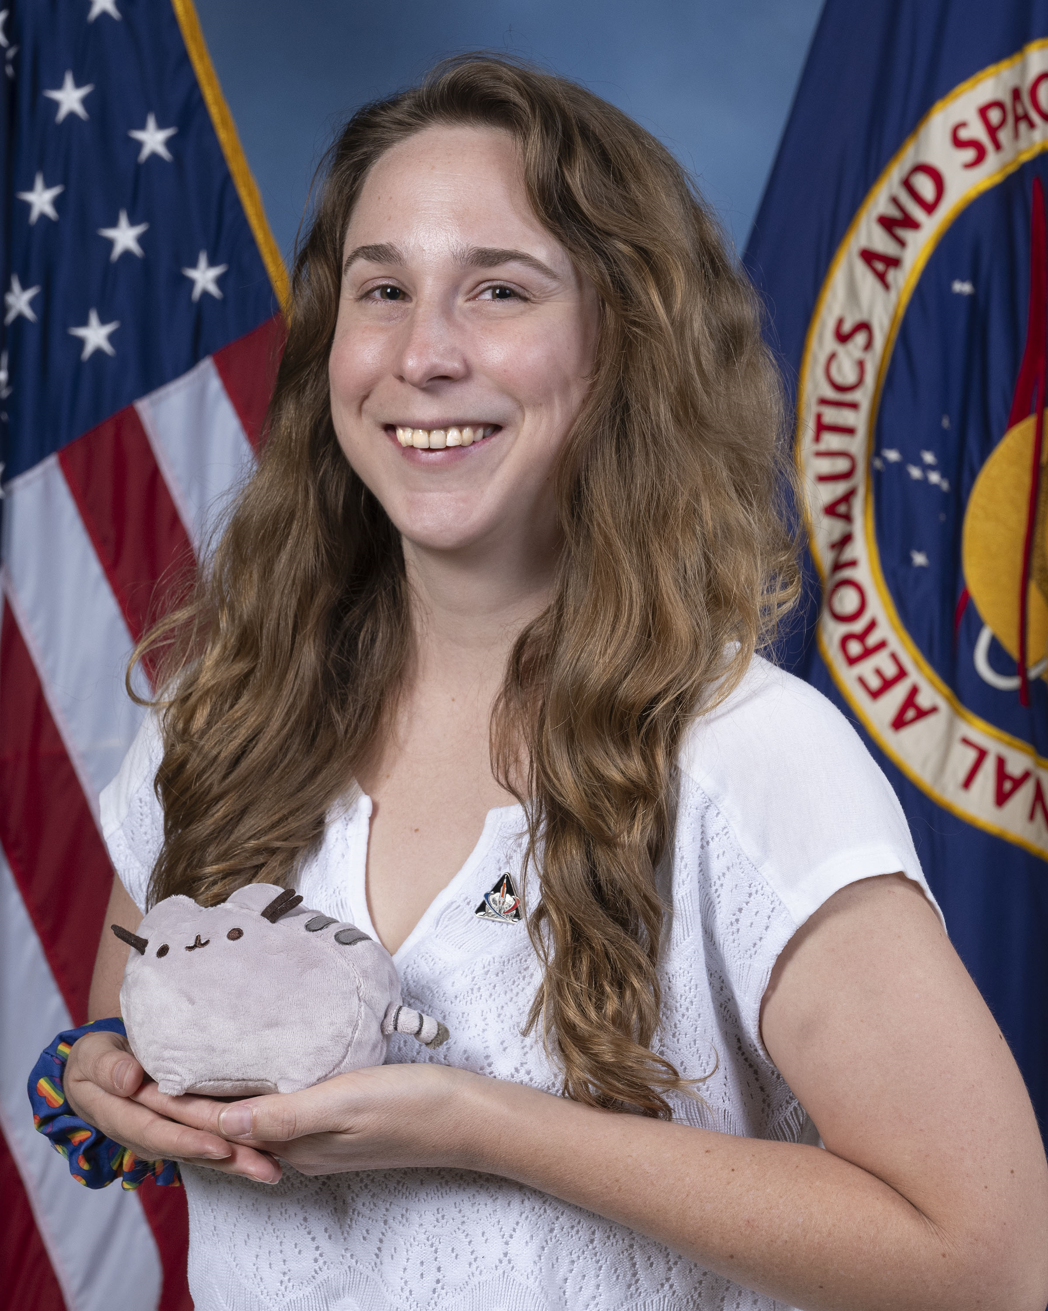
Sponsor and Advisor
Megan Reid
Annette Gray
NASA-Marshall Space Flight Center
Mentor
Marvin Barnes
NASA-Marshall Space Flight Center
Sponsor
Dr. Shayne McConomy
FAMU-FSU College of Engineering
Advisor

Slide 4
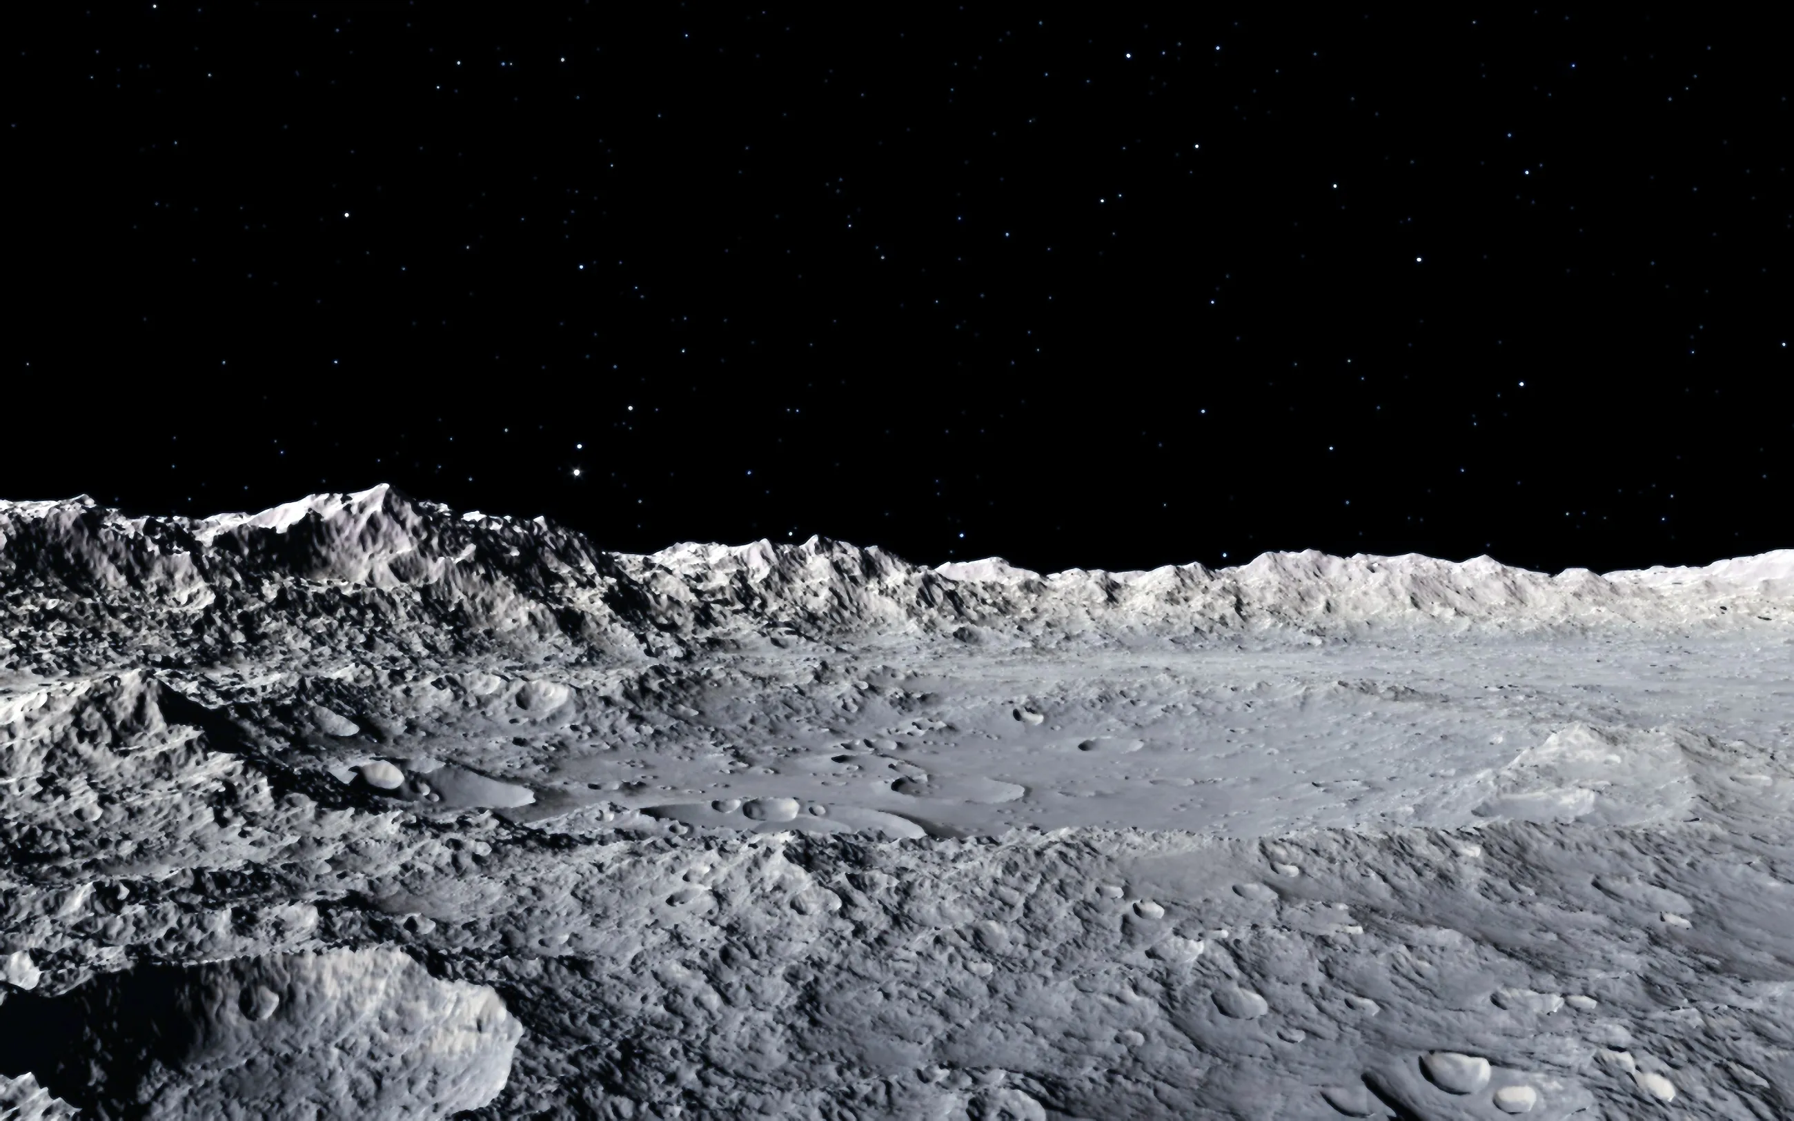
Objective
Megan Reid
Develop a solution to maintain water ice in lunar regolith while reaching high vacuum pressure

Slide 5
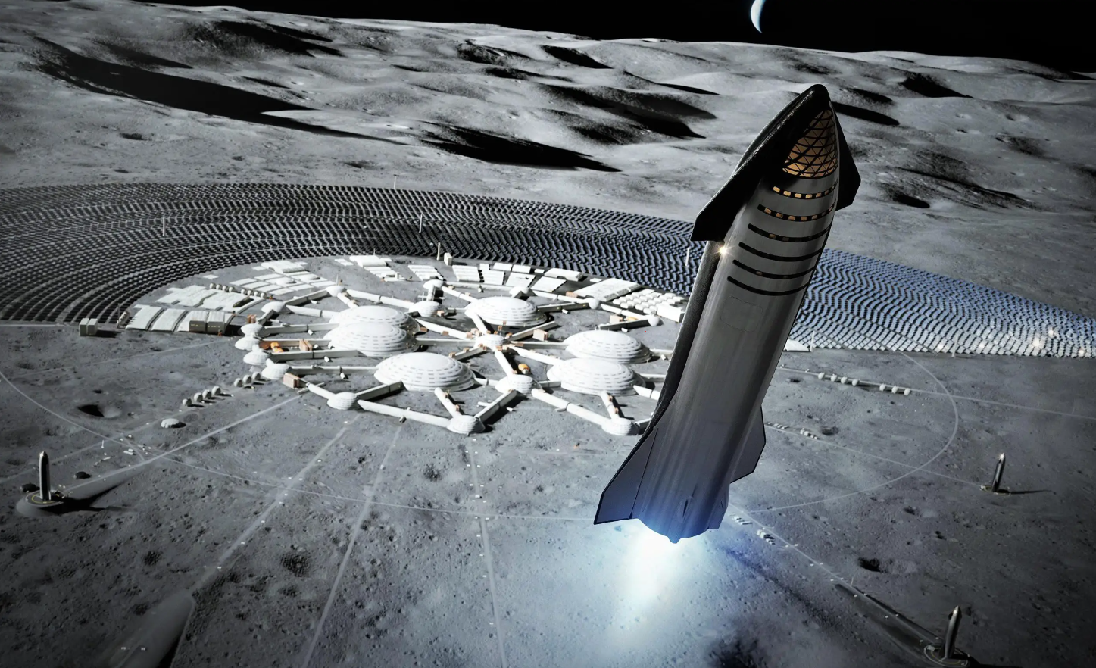
Space Exploration
Megan Reid
To enable human travel throughout the solar system, a lunar colony will be a necessity
Lunar refueling station:
Lower gravity
Water ice in shadowed craters
Convert H₂O --> H₂ + O for spacecraft fuel
NASA is exploring technologies for extraction of lunar water ice from lunar regolith
Notes:
To allow for human travel throughout the solar system, it is believed a lunar colony will be a necessity.
Rather than embarking from Earth, a lunar station will significantly more energy efficient as the moon has a much weaker gravitational force to overcome.
It is believed the moon has water ice hidden in permanently shadowed areas of craters.
Convert H2O --> H2 + O

Slide 6
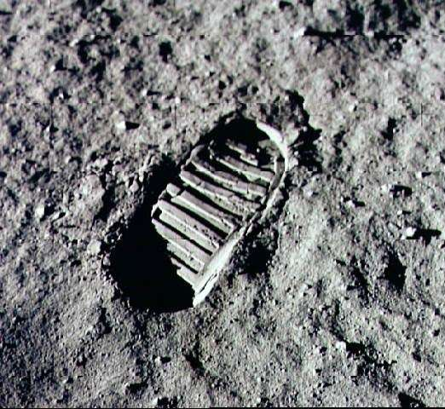
Lunar Regolith
Megan Reid
Insulator
Variable grain size and
particle size
Made of rock chips, mineral fragments, impact and volcanic glasses
Notes:
Made of rock chips, mineral fragments, impact and volcanic glasses and a Moon component called “agglutinates”

Slide 7
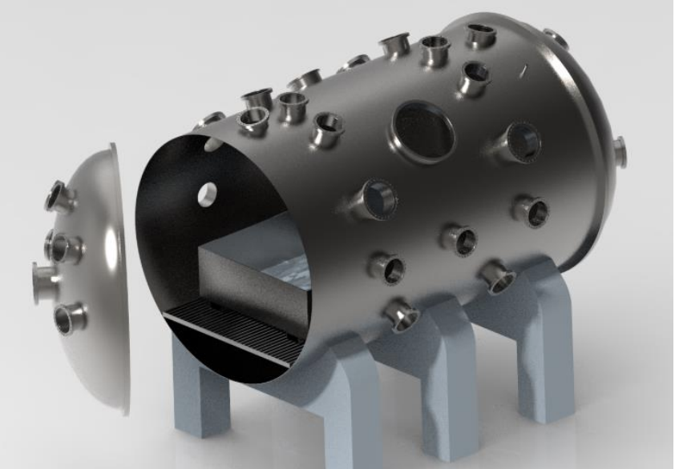
PLANET Chamber Planetary, Lunar, and Asteroid Natural Environments Testbed
Megan Reid
A high-fidelity lunar surface environment inside a well equipped high-vacuum chamber at NASA’s Marshall Space Flight Center

Slide 8
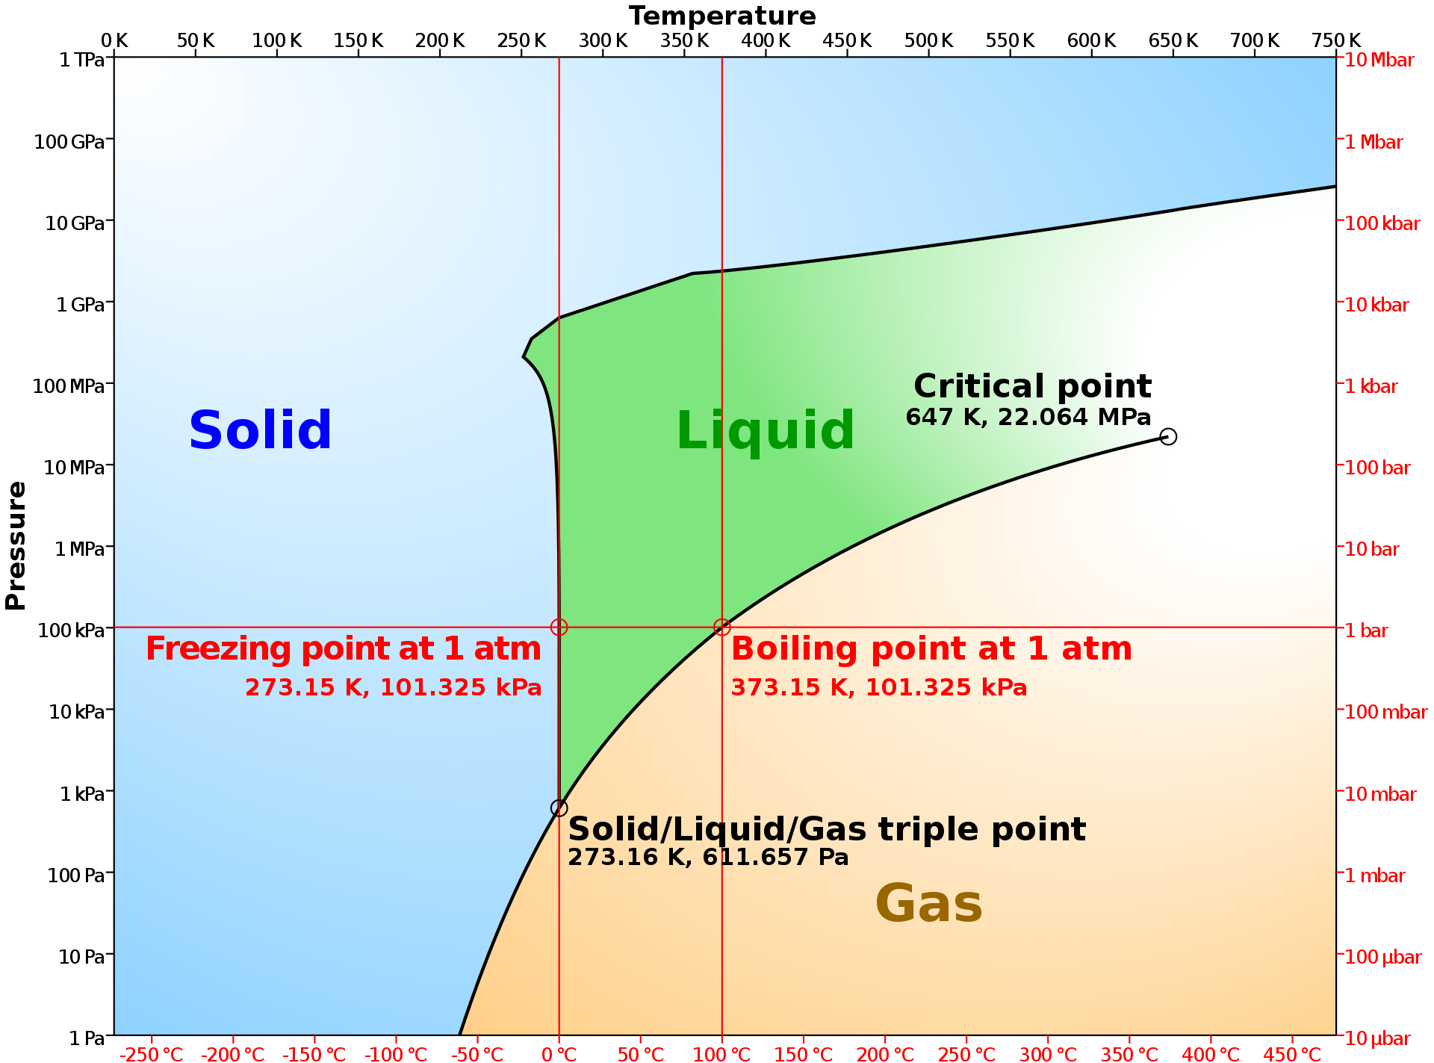
Properties of Water
Megan Reid
Notes:
Water Phase Diagram
Lots of energy when saying going down to this pressure without sublimating – main reason we are here

Slide 9
Properties of Water
Megan Reid
Notes:
Lots of energy when saying going down to this pressure without sublimating – main reason we are here

Slide 10
Properties of Water
Megan Reid
Notes:
Lots of energy when saying going down to this pressure without sublimating – main reason we are here

Slide 11
Properties of Water
Megan Reid
Notes:
Lots of energy when saying going down to this pressure without sublimating – main reason we are here

Slide 12
Properties of Water
Megan Reid
Notes:
Lots of energy when saying going down to this pressure without sublimating – main reason we are here

Slide 13
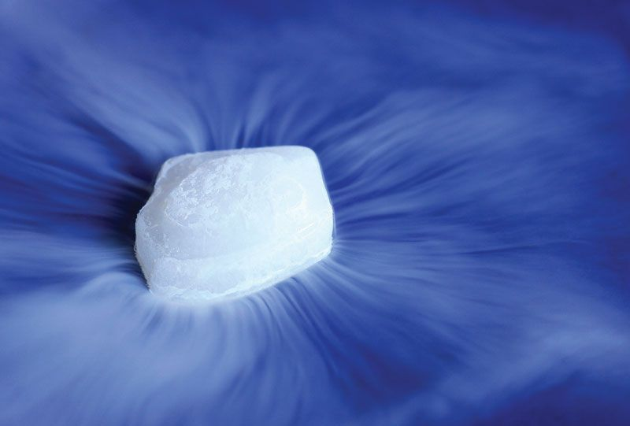
Current Issue
Megan Reid
Water ice in regolith will sublimate to gas if not cold enough before high vacuum
Water vapor condenses out of air when cooled before vacuum
Notes:
Water VAPOR, condenses out of air when cooled before vacuum...
affecting regolith-water content

Slide 14
Megan Reid
Key Goals
Thermal Maintenance
Notes:
Cool regolith simulant bed before and during high vacuum (10^-7 Torr)
Regolith needs to be cooled to a low enough temperature before depressurization so that water ice doesn’t sublimate
Needs to fit within the NASA PLANET Chamber

Slide 15
Megan Reid
Key Goals
Thermal Maintenance
Regolith
Notes:
Cool regolith simulant bed before and during high vacuum (10^-7 Torr)
Regolith needs to be cooled to a low enough temperature before depressurization so that water ice doesn’t sublimate
Needs to fit within the NASA PLANET Chamber

Slide 16
Megan Reid
Key Goals
Thermal Maintenance
Regolith
PLANET
Chamber
Notes:
Cool regolith simulant bed before and during high vacuum (10^-7 Torr)
Regolith needs to be cooled to a low enough temperature before depressurization so that water ice doesn’t sublimate
Needs to fit within the NASA PLANET Chamber

Slide 17
Megan Reid
Key Goals
Thermal Maintenance
Regolith
PLANET
Chamber
High Vacuum
Notes:
Cool regolith simulant bed before and during high vacuum (10^-7 Torr)
Regolith needs to be cooled to a low enough temperature before depressurization so that water ice doesn’t sublimate
Needs to fit within the NASA PLANET Chamber

Slide 18
Megan Reid
Assumptions
Materials provided for final testing at NASA - MSFC
Operating Conditions
PLANET Chamber
Humidity is controlled at 65%
Instrumentation
Cooling with Cryogenic Liquids
Regolith Simulant
No extreme conditions
Notes:
Following Materials will supplied:
Liquid Nitrogen
Regolith Simulant
Vacuum Chamber
Instrumentation
Final testing conducted at Marshall Space Flight Center
Humidity is at 65% (controlled)

Slide 19
Markets & Stakeholders
Megan Reid
NASA - MSFC
SpaceX
Boeing
Blue Origin
Other Private Aerospace Companies
Notes:
Primary:
NASA
Secondary:
SpaceX, Boeing, or Blue Origin
Private aerospace companies developing extraction and excavation technologies

Slide 20
Customer Needs
Luke Leibkuchler
Water
Phase
Uniform
Properties
Monitor
Properties
PLANET
Chamber
Pressure

Slide 21
Customer Needs
Luke Leibkuchler
Water
Phase
Uniform
Properties
Monitor
Properties
PLANET
Chamber
Pressure
Maintain water in the solid phase
Water will be in the regolith

Slide 22
Customer Needs
Luke Leibkuchler
Water
Phase
Uniform
Properties
Monitor
Properties
PLANET
Chamber
Pressure
Maintain water in the solid phase
Water will be in the regolith
Operates in atmospheric to high vacuum pressure
Mimics space environment

Slide 23
Customer Needs
Luke Leibkuchler
Water
Phase
Uniform
Properties
Monitor
Properties
PLANET
Chamber
Pressure
Maintain water in the solid phase
Water will be in the regolith
Operates in atmospheric to high vacuum pressure
Mimics space environment
Reaches desired moisture, pressure, and temperature in regolith

Slide 24
Customer Needs
Luke Leibkuchler
Water
Phase
Uniform
Properties
Monitor
Properties
PLANET
Chamber
Pressure
Maintain water in the solid phase
Water will be in the regolith
Operates in atmospheric to high vacuum pressure
Mimics space environment
Reaches desired moisture, pressure, and temperature in regolith
Ability to monitor moisture, pressure, and temperature in regolith

Slide 25
Customer Needs
Luke Leibkuchler
Water
Phase
Uniform
Properties
Monitor
Properties
PLANET
Chamber
Pressure
Maintain water in the solid phase
Water will be in the regolith
Operates in atmospheric to high vacuum pressure
Mimics space environment
Reaches desired moisture, pressure, and temperature in regolith
Ability to monitor moisture, pressure, and temperature in regolith
Fits into and is compatible with the PLANET Chamber

Slide 26
Functional Decomposition
Luke Leibkuchler
NASA Cooling Fixture
Thermal
Controls
Structure

Slide 27
Functional Decomposition
Luke Leibkuchler
NASA Cooling Fixture
Thermal
Controls
Structure
Pre Pump Down
Post Pump Down
Control Water Composition
Cool Entire Mass to Cryogenic Temperatures
Pump to High Vacuum

Slide 28
Functional Decomposition
Luke Leibkuchler
NASA Cooling Fixture
Thermal
Controls
Structure
User Interface
Motion
Data Acquisition
Display Properties
Open and Close Hatch

Slide 29
Functional Decomposition
Luke Leibkuchler
NASA Cooling Fixture
Thermal
Controls
Structure
Cool Entire Mass to Cryogenic Temperatures
User Interface
Motion
Data Acquisition
Display Properties
Open and Close Hatch

Slide 30
Functional Decomposition
Luke Leibkuchler
NASA Cooling Fixture
Thermal
Controls
Structure
Withstand PLANET
Operate within PLANET
Protect Electrical Components
Structural Integrity at Extreme Conditions
Move In and Out of Chamber
Fit Within Dimensions

Slide 31
Functional Decomposition
Luke Leibkuchler
NASA Cooling Fixture
Thermal
Controls
Structure
Controls
Hatch
Withstand PLANET
Operate within PLANET
Protect Electrical Components
Structural Integrity at Extreme Conditions
Move In and Out of Chamber
Fit Within Dimensions

Slide 32
Future Work
Luke Leibkuchler
Target &
Metrics
Prototypes
Risk
Assessment
Create prototypes of high-fidelity concepts to aid in selection
Set targets and metrics for system
Perform risk assessment
Generate 100 ideas for solution that fits needs and targets
Select final concept
Create bill of materials
Concept
Generation
Concept
Selection
Bill of
Materials
Meet with advising team
Notes:
Targets and Metrics
Concept Generation and Selection
Prototypes
Biweekly Sponsor Meetings
Risk Assessment
Bill of Materials
Spring Project Plan

Slide 33
Thank You!
Notes:
Targets and Metrics
Concept Generation and Selection
Prototypes
Biweekly Sponsor Meetings
Risk Assessment
Bill of Materials
Spring Project Plan

Slide 34
Backup Slides

Slide 35
Backup Slides

Slide 36
Backup Slides

Slide 37
Stake holders
Notes:
NASA
National High Magnetic Field Lab (Maglab)
Dr. McConomy

Slide 38
Properties of Water
Megan Reid

Slide 39
Customer Needs
Luke Leibkuchler
Maintain Water at Ice in Regolith
Operate in Atmospheric to High Vacuum Pressure
Uniform Moisture, Pressure, and Temperature in Regolith
Ability to Monitor Properties
Operate in PLANET Chamber

Slide 40
Customer Needs
Luke Leibkuchler
Maintain Water at Ice in Regolith
Operate in Atmospheric to High Vacuum Pressure
Uniform Moisture, Pressure, and Temperature in Regolith
Ability to Monitor Properties
Operate in PLANET Chamber

Slide 41
Customer Needs
Luke Leibkuchler
Maintain Water at Ice in Regolith
Operate in Atmospheric to High Vacuum Pressure
Uniform Moisture, Pressure, and Temperature in Regolith
Ability to Monitor Properties
Operate in PLANET Chamber

Slide 42
Customer Needs
Luke Leibkuchler
Maintain Water at Ice in Regolith
Operate in Atmospheric to High Vacuum Pressure
Uniform Moisture, Pressure, and Temperature in Regolith
Ability to Monitor Properties
Operate in PLANET Chamber

Slide 43
Customer Needs
Luke Leibkuchler
Maintain Water at Ice in Regolith
Operate in Atmospheric to High Vacuum Pressure
Uniform Moisture, Pressure, and Temperature in Regolith
Ability to Monitor Properties
Operate in PLANET Chamber

Slide 44
Customer Needs
Luke Leibkuchler
Maintain Water at Ice in Regolith
Operate in Atmospheric to High Vacuum Pressure
Uniform Moisture, Pressure, and Temperature in Regolith
Ability to Monitor Properties
Operate in PLANET Chamber

Slide 45
Markets & Stakeholders
Megan Reid
NASA
MagLab
Private Aerospace Companies
FAMU-FSU
Notes:
Primary:
NASA
Secondary:
SpaceX, Boeing, or Blue Origin
Private aerospace companies developing extraction and excavation technologies

Slide 46
Customer Needs
Maintain Water at Ice
Operate in Atmospheric to High Vacuum Pressure
Uniform Moisture, Pressure, and Temperature in Regolith
Ability to Monitor Properties
Operate in PLANET Chamber

Slide 47
Functional Decomposition
Luke Leibkuchler
NASA Regolith Cooling Fixture
Thermal
Structure
Controls

Slide 48
Functional Decomposition
Luke Leibkuchler
NASA Regolith Cooling Fixture
Thermal
Structure
Controls

Slide 49
Functional Decomposition
Luke Leibkuchler
Thermal
Pre Pump Down
Post Pump Down
Water in Air
Cool Entire Mass to Cryogenic Temperatures
High Vacuum

Slide 50
Functional Decomposition
Luke Leibkuchler
NASA Regolith Cooling Fixture
Thermal
Structure
Controls

Slide 51
Functional Decomposition
Luke Leibkuchler
Controls
User Interface
Motion
Data Acquisition
Display
Hatch

Slide 52
Functional Decomposition
Luke Leibkuchler
NASA Regolith Cooling Fixture
Thermal
Structure
Controls

Slide 53
Functional Decomposition
Luke Leibkuchler
Structure
Operate within PLANET
Withstand PLANET
In and Out of Chamber
Within Dimensions
Electrical Components
Integrity at Extreme Conditions

Slide 54
Functional Decomposition
Thermal
Pre-Pump Down
Post-Pump Down
Prevent water condensation
Cool entire regolith mass to –180 degC
Maintain high vacuum pressure within the fixture
Maintain specific regolith-water composition

Slide 55
Functional Decomposition
Structure
Operate within PLANET chamber
Withstand PLANET conditions
Protect electrical/
mechanical components
Maintain structural integrity
Allows transport in and out of chamber
Fit within chamber dimensions
Withstands cryogenic temperatures
Withstands high vacuum
Utilizes materials invisible to microwave radiation
Allows flow of coolant

Slide 56
Functional Decomposition
Controls
Motion
User Interface
DAQ
Display
Open hatch for testing
Close hatch after testing
Collect water moisture and fixture pressure data
Collect
temperature data
Display water moisture and fixture pressure data
Display hatch position data
Collect hatch position data
Collect coolant flow rate data
Display temperature data
Display coolant flow rate data

Slide 57
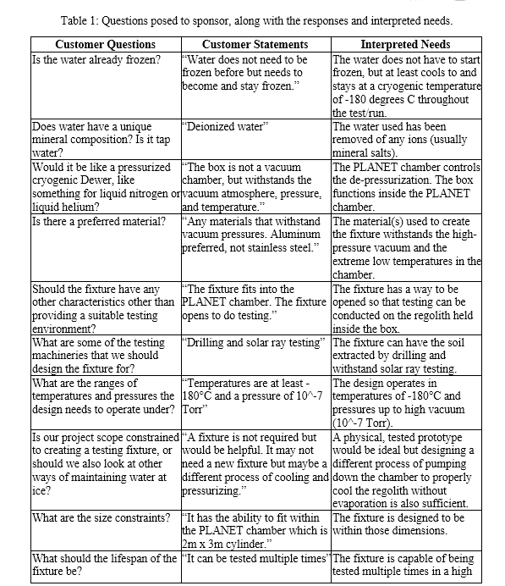
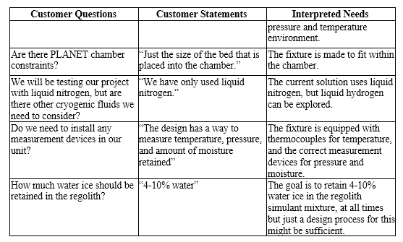
Customer Needs

Slide 58
This is 10-point
This is 15–point Times
This is 20–point
This is 25–point
This is 30–point
This is 35–point
This is 40–point
This is 50–point
This is 60–point
This is 72–point
Notes:
Use at least 20-point font in Room A105, B134, and B136
Use at least 25-point font in Room B135

Slide 59
College of Engineering Color Palette
1 2 3 4
Pantone: PMS 195 C
RGB: 120, 47, 64
Hex: #782F40
CMYK:19, 90, 50, 55
1 2 3 4
Pantone: Black C
RGB: 0, 0, 0
Hex: #000000
CMYK:0, 0, 0, 100
Garnet
Black
1 2 3 4
RGB: 238, 118, 36
Hex: #EE7624
CMYK:2, 66, 99, 0
1 2 3 4
Pantone: PMS 000C
RGB: 255, 255, 255
Hex: #FFFFFF
CMYK: 0, 0, 0, 0
Fang
Orange
White
Notes:
Avoid 75% Black in B135

Slide 60
Accent Color Palette
1 2 3 4
RGB: 0, 59, 111
Hex: #003B6F
CMYK:
1 2 3 4
RGB: 0, 59, 111
Hex: #003B6F
CMYK:
1 2 3 4
RGB: 251, 236, 93
Hex: #FBEC5D
CMYK:
1 2 3 4
RGB: 219, 215, 210
Hex: #DBD7D2
CMYK:
1 2 3 4
RGB: 251, 236, 93
Hex: #FBEC5D
CMYK:
1 2 3 4
RGB: 219, 215, 210
Hex: #DBD7D2
CMYK:
Tardis Blue
Tardis Blue
Corn
Timberwolf
Corn
Timberwolf
1 2 3 4
RGB: 206, 0, 88
Hex: #CE0058
CMYK: 0, 100, 43, 12
1 2 3 4
RGB: 206, 0, 88
Hex: #CE0058
CMYK: 0, 100, 43, 12
1 2 3 4
RGB: 104, 40, 96
Hex: #682860
CMYK:
1 2 3 4
RGB: 220, 220, 220
Hex: #DCDCDC
CMYK:
Rubine Red
Rubine Red
Imperial
Gainsboro
1 2 3 4
RGB: 72, 146, 155
Hex: #48929b
CMYK:
1 2 3 4
RGB: 64, 224, 208
Hex: #40E0D0
CMYK:
1 2 3 4
RGB: 255, 139, 0
Hex: #FF8B00
CMYK:
Asagi-iro
Turquoise
American Orange
Notes:
Remove American orange add hyperlink grey
Make corn the last for b135
All work in 134 imperial move later
Tardis doesn’t work in b136

Slide 61
F7AB19
D67F15
EE7624
D64615
F73119
Analogous
https://color.adobe.com/create/color-wheel
6E3610
F0A16C
EE7624
6E4931
BASB1C
Monochromatic
A14508
4BED3B
EE7624
250CED
2010A1
Triad
A1470C
FF8C40
EE7624
0098A1
24E2ED
Complementary
28A164
2FED8D
EE7624
0848A1
1871ED
Split Complementary
EDAC2F
3BED93
EE7624
0C6AED
ED2F18
Double Split Complementary
ED660C
C7ED3B
EE7624
0CE1ED
A418ED
Square
BA7E09
87724A
EE7624
60EFCF
09BA61
Compound
AD551A
6E3610
EE7624
FA7625
D46820
Shades
Notes:
These are the variants that work well with Fang Orange. The bolded items show well on the projectors.

Slide 62
85412D
8F3831
782f40
8F3176
792D85
Analogous
https://color.adobe.com/create/color-wheel
C44D69
8E626D
782F40
C48796
451B25
Monochromatic
C43959
78743B
782F40
236178
43A2C4
Triad
C43959
C46078
782F40
25C43D
2F783A
Complementary
93C460
577835
782F40
39C49D
297861
Split Complementary
784435
5A783B
782F40
237860
6E2978
Double Split Complementary
782337
78683b
782F40
237830
293978
Square
AB4D32
DEBAAF
782F40
5D8555
70AB32
Compound
38161E
C44D69
782F40
853447
5E2532
Shades

Slide 63
A105
A105
B135 Stage Left
B135 Stage Right
B136
B134, A105
B135

